Slide 1

Database Design

Slide 2
Database Design
Objectives :
  State the phases in database design
  Tell what is E-R Model
  Define Entity and Attributes
  List Attribute types
  List & Identify E-R notations
  Identify the need of normalization
  Explain what is Normalization
  State & demonstrate the use of Normal Forms

Slide 3
Database Design
Phases in Database Design
Conceptual Design
  Data modeling ( E-R Diagrams)
  Normalisation

Slide 4
Database Design - Phases
Processing Requirements
User Requirements
Requirements
Formulation & Analysis
DBMS Characteristics
Requirement Specifications
Conceptual Design
Information Structure
Implementation Design
Logical Database Structure
Hardware, Operating System Characteristics
Physical
Design

Slide 5
Entity Relationship Model
The Entity-Relationship (E-R) data model is based on a perception of a real world that consists of a basic set of objects called entities, and of relationships among these objects

Slide 6
Entity Relationship Model
Facilitates database design
Represents overall logical structure of a database
Useful in mapping the meanings and interactions of real-world entities onto conceptual schema

Slide 7
Entity
An entity is a ‘thing’ or an ‘object’ in real world that is distinguishable from all other objects
An entity has a set of attributes that describe the entity

Slide 8





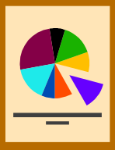



Entity - Examples

Slide 9
Attribute
An entity has a set of attributes that describe it
Values for some set of attributes may uniquely identify that entity
Example :
Identify the attributes associated with entities like employee, customer, vehicle.

Slide 10
Relationship
A relationship is an association among several entities
Cardinality of relationship
  Cardinality express the number of entities to which another entity can associated via relationship set

Slide 11
Relationship
Cardinality Types
  One to One
  One to Many
  Many to One
  Many to Many

Slide 12
Data Modeling : E-R Diagram
Entity Relationship Diagram
  Identifies data objects and their relationships
  Uses a graphical notation

Slide 13
E-R Notations
Rectangle: Entity
  Data object in the system uniquely identifiable by identifier
  Has attributes that describe it
  Example
Employee

Slide 14
E-R Notations
Ellipse: Attribute
  Describes an entity
  Example
Ename
Empno
Employee

Slide 15
E-R Notations
Diamond: Relationship
  Represents relationship among entities
  Relates two entities by identifiers
  Example
Works
M
1
Employee
Department

Slide 16
E-R Notations
Line: Link
  Links attributes to entities and entities to relationship

Slide 17
Un-normalised Data Structures
Contains redundant and disorganised data
Changing data in some tables can have undesirable consequences called anomalies
Types of Anomalies
  Insertion
  Deletion
  Update

Slide 18
Normalisation
An analytical technique used during logical database design
Refinement of the Data Model
Segregation of data over many entities or tables
Offers a strategy for constructing tables and identifying keys
Normalised model converted to physical database tables

Slide 19
Need for Normalisation
Improves database design
Ensures minimum redundancy of data
Reduces need to reorganise data when design is modified / enhanced
Removes anomalies for database activities

Slide 20
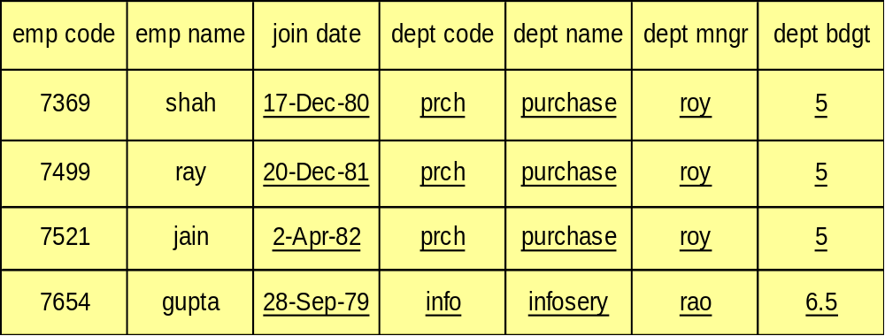
Why Normalize - 1
redundancy

Slide 21

Why Normalize - 2
Deletion anomaly

Slide 22
Why Normalize - 3
Update anomaly

Slide 23
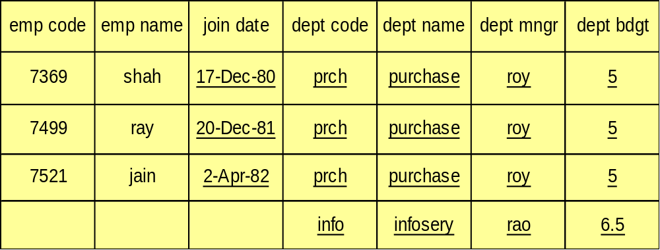
Why Normalize - 4
Insertion anomaly

Slide 24
Normalisation Forms
First Normal Form
Second Normal Form
Third Normal Form

